Slide 1
3D-CHESS: Decentralized, Distributed, Dynamic and Context-aware Heterogeneous Sensor Systems Project Overview
Alan Aguilar Jaramillo

Slide 2
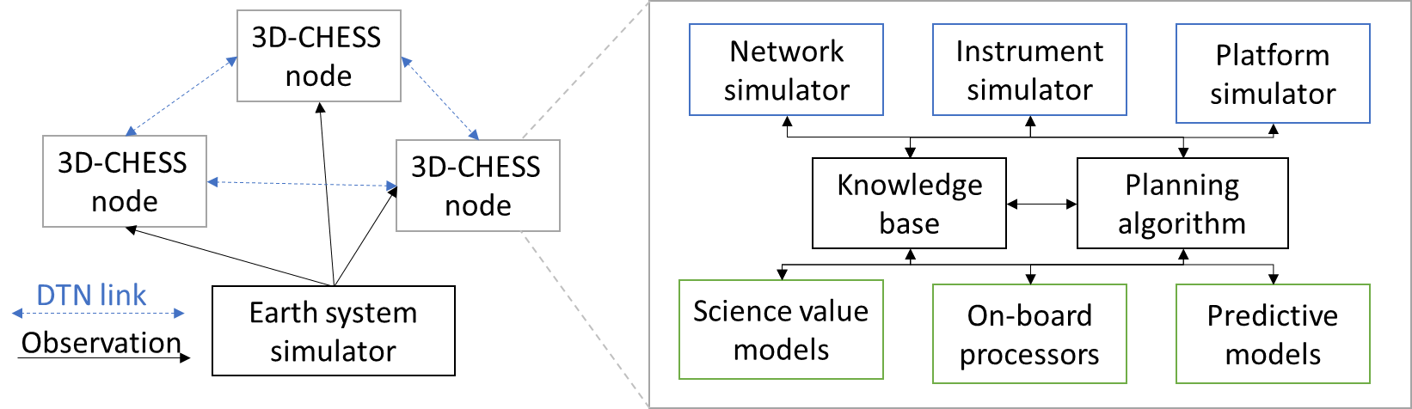
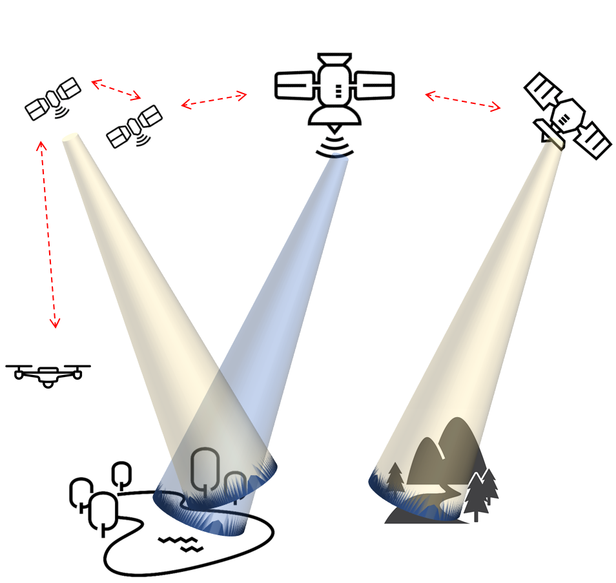
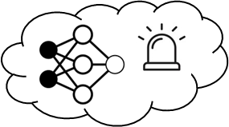
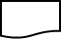
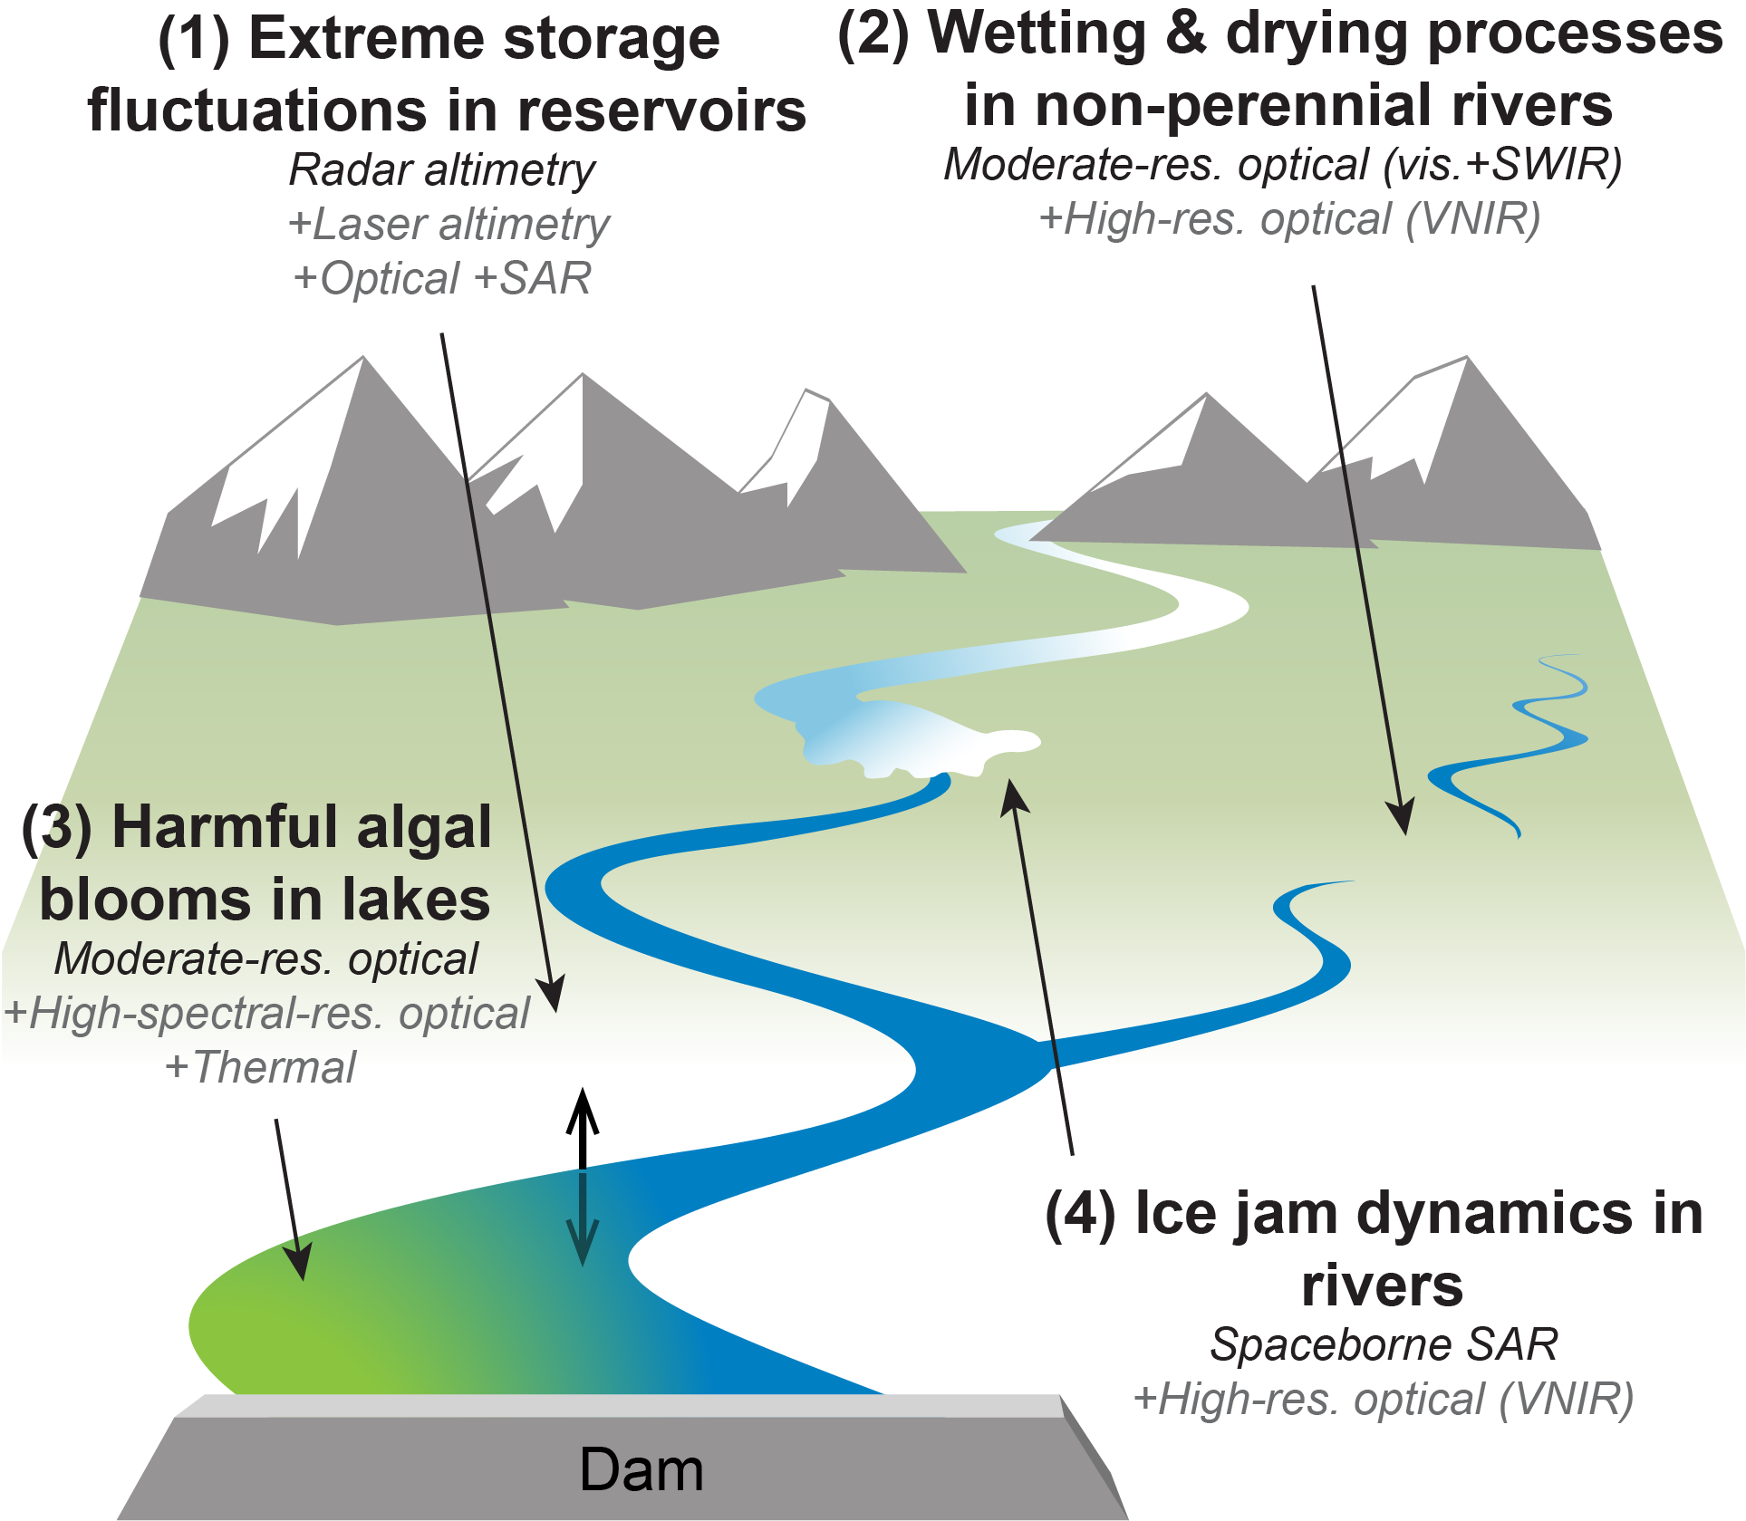
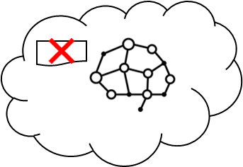
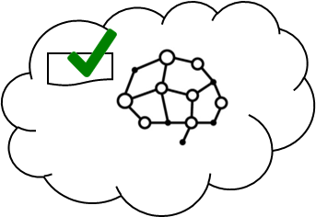
3D-CHESS: Decentralized, Distributed, Dynamic, and Context-aware HEterogeneous Sensor Systems
PI: Daniel Selva, Texas A&M University
Objective
Demonstrate proof of concept (TRL 3) for a context-aware Earth observing sensor web of interconnected space, air and ground nodes.
Context awareness: ability for the nodes to gather, exchange, and reason about contextual information (e.g., state of the observable, state and capabilities of itself and of other nodes in the network and how those relate to the task request and mission objectives).
Demonstrate the technology and assess the value of contextual information in a multi-sensor in-land hydrologic and ecologic monitoring system with four inter-dependent mission objectives: studying intermittent rivers and sediment transport, and monitoring floods and algal blooms
Approach
Key Milestones
Knowledge graph reasoning using UniKER algorithm allows nodes to determine if they can perform a task
Decentralized planning using modified CCBBA algorithm
Platform/Instrument/Network simulators using existing tools (PyOrbit, InstruPy, and dtnSim) provide realistic engineering constraints to planning algorithms
Simple science models provide reasonable science-driven estimates of scientific/societal value of observations to planning algorithms
Multi-agent simulation to benchmark 3D-CHESS against status quo and intermediate “transition” architectures
Kick-off 08/22
System architecture/interfaces defined 11/22
Initial Integration and verification complete 01/23
Performance in basic case characterized (TRL 2) 03/23
Value of technology characterized in basic case 09/23
Multi-mission use case demonstrated (TRL 3) 11/23
TRL_{in} = 1-2
TRL_{current} = 1-2
Co-Is/Partners: George Allen (VT); Huilin Gao (TAMU); Ankur Mehta, Yihzou Sun (UCLA); Vinay Ravindra (ARC); Cedric David (JPL).
11/21
AIST-21-0089

Slide 3
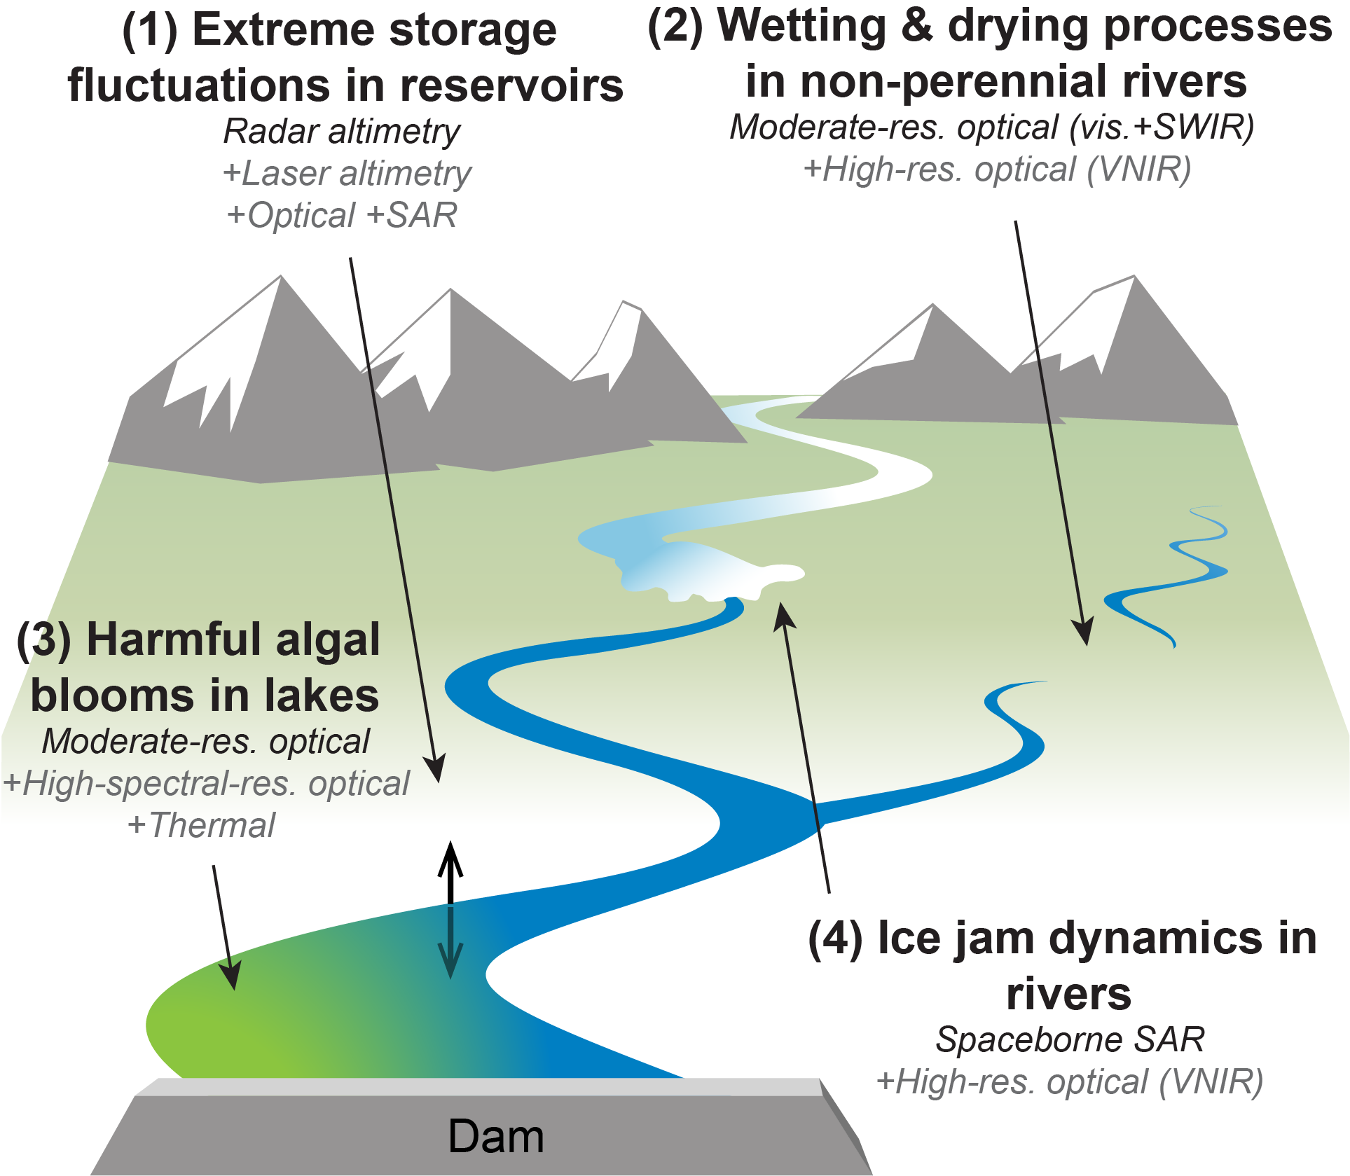
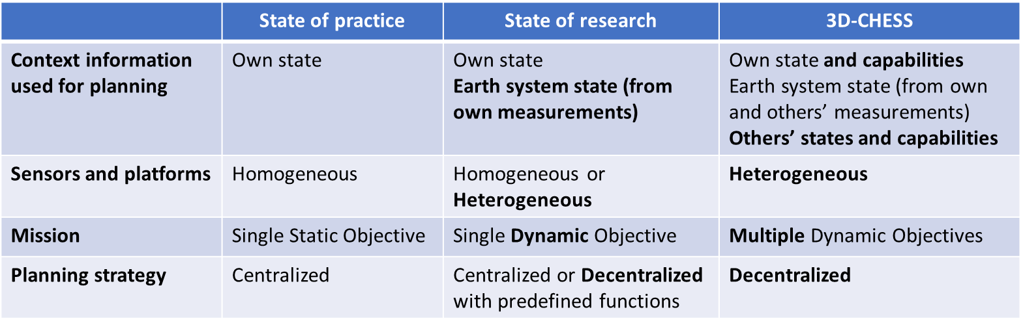
Background/Objectives
Overarching Goal: To provide proof of concept (TRL 3) for a context-aware network of heterogeneous sensors, in the context of an inland water ecosystem monitoring mission
Inland water bodies can dramatically change states within minutes to hours.
These changes are increasingly extreme and difficult to predict due to climate change.
Need for high spatial, temporal, and/or spectral resolutions, from heterogeneous sensors.
To monitor and respond to a dynamic environment, significantly more autonomy is needed in the Earth observing systems.
Autonomy requires context awareness and decentralized coordination.
Relevant to Objective O1: Enable new observation measurements and new observing systems design and operations through intelligent, timely, dynamic, and coordinated distributed sensing.
Relevant missions: SWOT, NISAR, Delta-X, SMASH

Slide 4
Background / Objectives
Enabling technologies: Knowledge graph reasoning algorithms (UniKER) and decentralized planning algorithms (MCCBBA).
Approach: Multi-agent simulation (message-driven) where each node consists of
Engineering module (platform, sensors, and network simulators) using EOSim
Science module (science value models, on-board processors, predictive models)
Planning module (knowledge-based reasoning, planning/scheduling)
Objectives: Use multi-agent simulator to assess feasibility, scalability and value of the 3D-CHESS concept vs various benchmarks in the context of the relevance scenario
Quantify the value of implementing 3D-CHESS compared to the status quo
Study “transition” architectures (somewhere btw. 3D-CHESS and status quo)
Study “federated” architectures (nodes owned & operated by different agencies)

Slide 5
3D-CHESS: Concept of operations
1 – Default missions; data processing
Each node in the system conducts its nominal mission, following a default plan (e.g., provide global coordinated observations of inland water quantity and quality.)
Nodes can be in space, air, or ground, and they can perform one or more functions (observation, data processing, communication)
Nodes with data processing capabilities process the data on board in real time and look for events of interest.

Slide 6
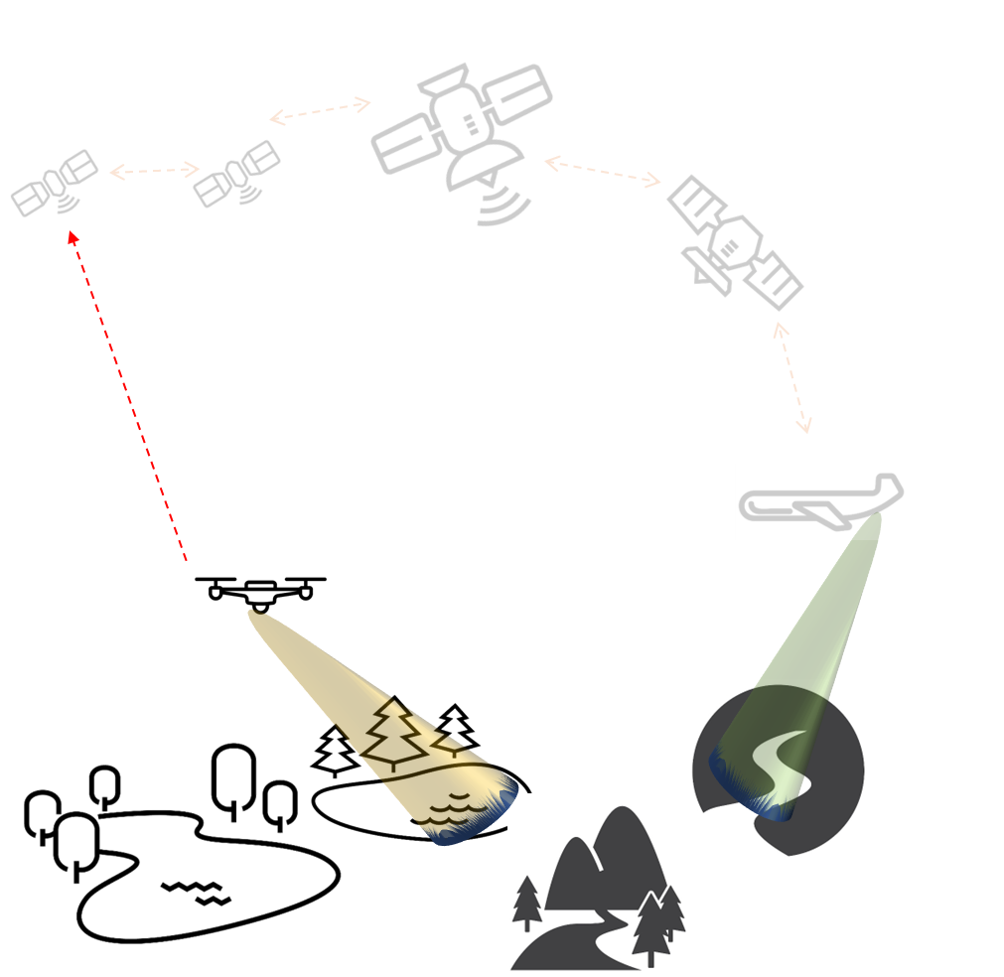
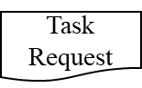
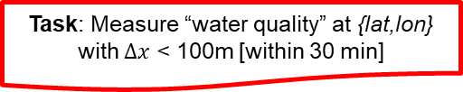

3D-CHESS: Concept of operations
2 – Event detected; task request sent
A node in the network detects (or predicts) an event of interest (e.g., a flood or a new intermittent river) at a certain location.
It sends a Task Request to the network.

Slide 7
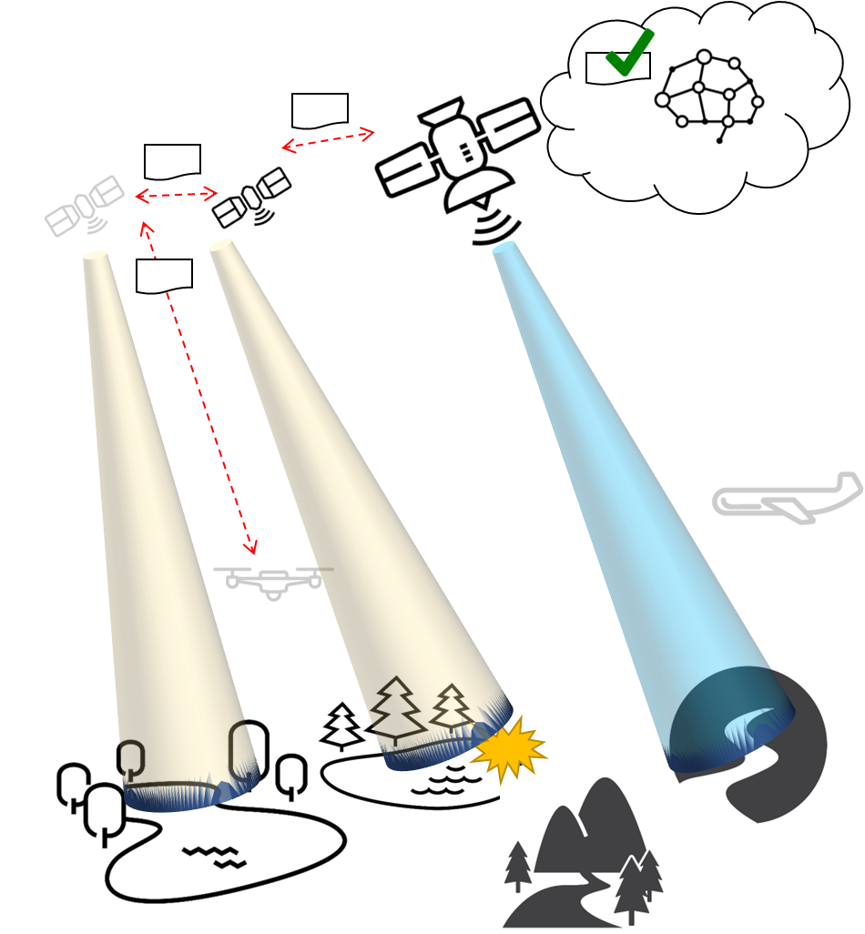
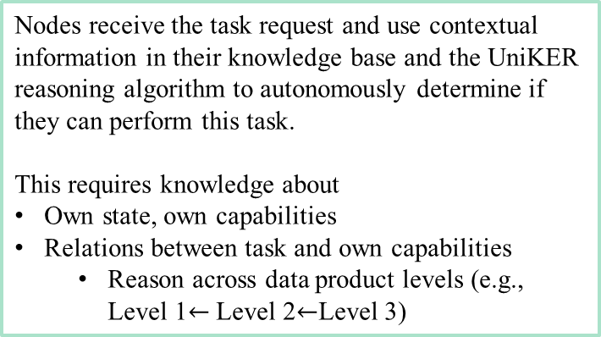
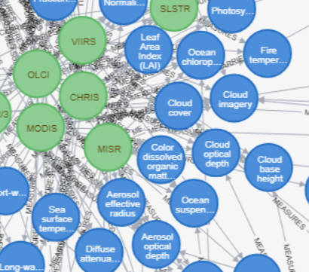
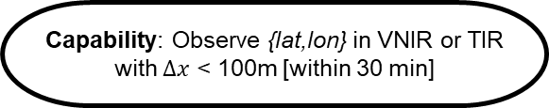
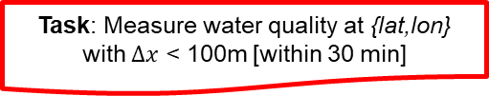
3D-CHESS: Concept of operations
3 – Instrument Capability Reasoning
CanBeObtainedFrom(WaterQuality, Chlorophyll-A)
CanBeObtainedFrom(Chlorophyll-A, VNIR_Radiances)

Slide 8
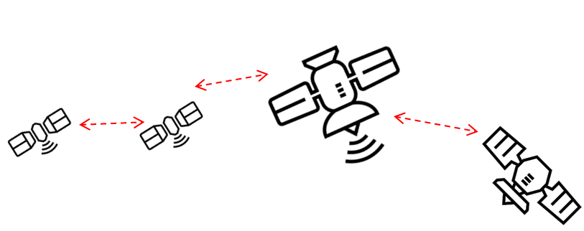
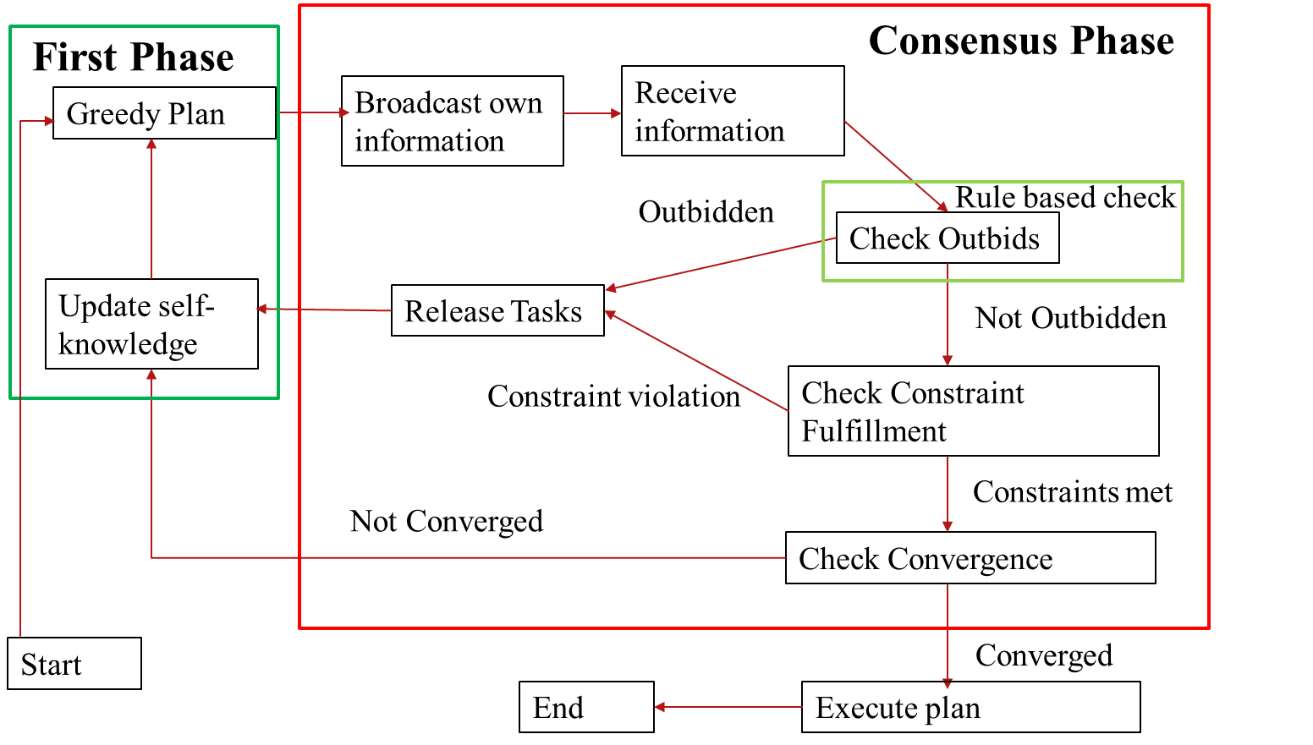
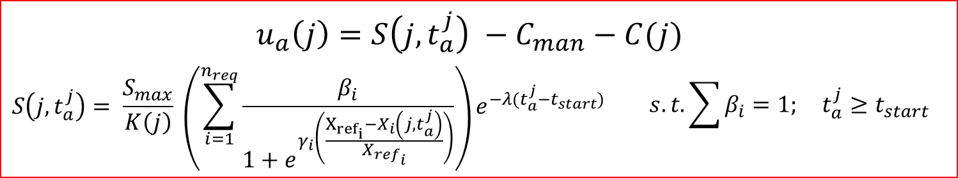
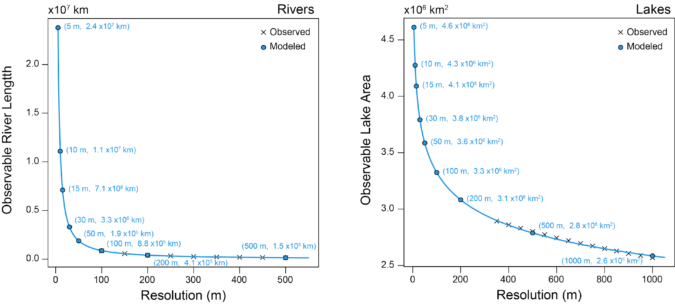
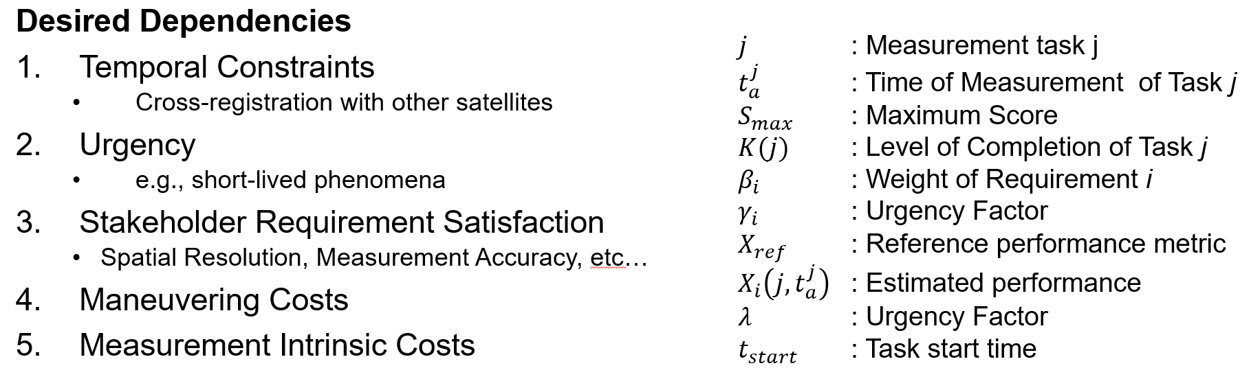
3D-CHESS: Concept of operations
4 – Decentralized planning
If they do, they enter a decentralized planning phase to coordinate who does what (MCCBBA algorithm).
Nodes use a science-driven utility function to determine if they should perform the task at the cost of temporarily abandoning their current mission. Engineering costs (e.g., energy) are also considered.
Once converged, the nodes update their plans.

Slide 9
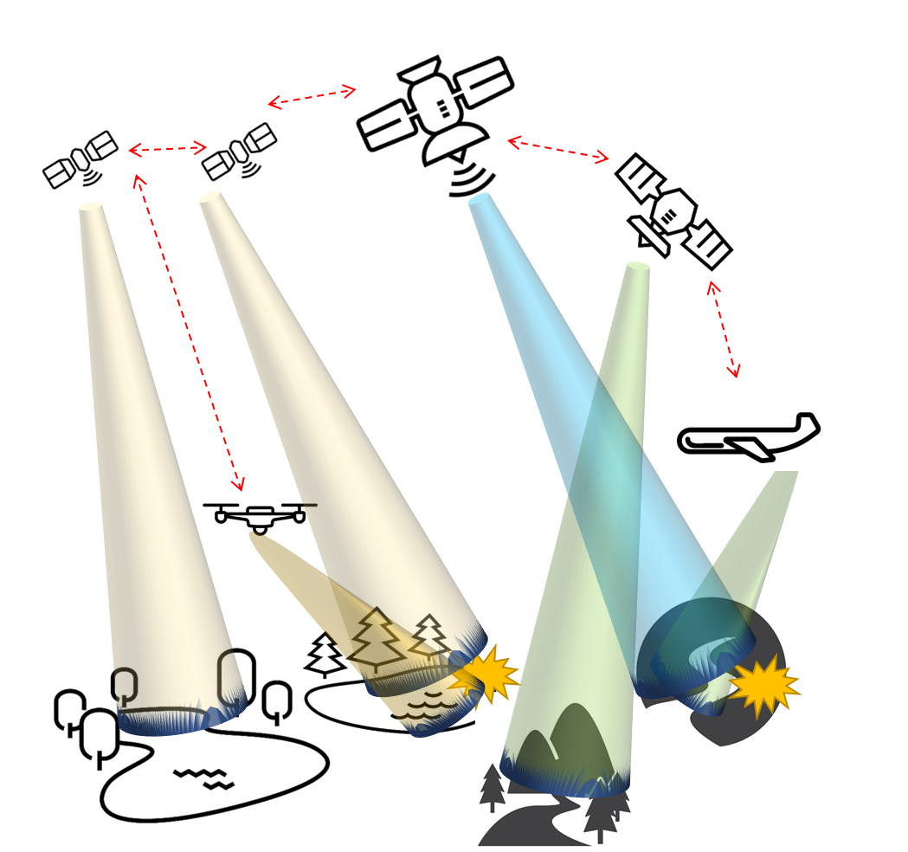
3D-CHESS: Concept of operations
5 – Updated plans; continue…
The pertinent nodes respond to the task request and the relevant images are taken and sent to the ground and/or the node that generated the task request.
The network continues to operate in this way. Nodes are added or removed from the network over time. Node states and the Earth system state change over time.
Nodes capabilities and relations between capabilities and tasks may also change slowly over time (e.g., new science discoveries!)

Slide 10
3D CHESS Project
Content Styling

Slide 11
Intro to Agents
Content Styling

Slide 12
DMAS
Content Styling

Slide 13






DMAS – Simulation Architecture
Env-to-agent
Sensing Data
Peer-to-peer
Data or Requests
Satellite Node
Environment Server
Manager broadcast
Sim start, end, or time
Satellite Node
Peer broadcast
Data or Requests
Results Logger
Simulation Manager
Node Results
Node state, actions performed, events detected/measured, etc.
Satellite Node
Ground Station Node
Simulation Manager controls nodes
Simulation start and end times
Agent synchronization routine during initialization
Publishes network information to all nodes
Results Logger tracks agents during the simulation
Agents push their results to logger as the simulation runs
Logger tracks incoming results as they are received
Environment still modeled as a server accessed by nodes
Simulates Earth system and inter-agent connectivity
Nodes “sense” the environment by requesting simulated data

Slide 14
Software Tools Install

Slide 15
Demo

Slide 16
“Quote, statistic call out, or closing slide to go here”

